Slide 1
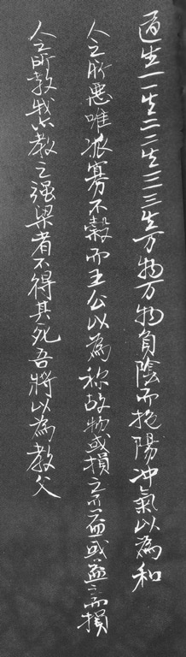









λ Calculus & Computability
Yan Huang
Dept. of Comp. Sci.
University of Virginia

Slide 2
Review of the Turing Machine
Formalism
Abstract Problems
Language Problems
Computation
Computability vs. Decidability
(
Q
¡
§
±
q
q
q
)
;
;
;
;
s
t
a
r
t
;
a
c
c
e
p
t
;
r
e
j
e
c
t
Today we are looking at a completely different formal computation model – the λ-Calculus!
Notes:
Abstract problem Q --– binary relation on a set I of problem instances and a set S of problem solutions.
Correspondence between abstract problems and language problems
Is there any problems that we don’t know whether they are decidable or not?
“Are there any lives in the outer space?“ – is this problem decidable?
Is this problem undecidable?
Church-Turing thesis

Slide 3

Calculus
What is calculus?
  Calculus is a branch of mathematics that includes the study of limits, derivatives, integrals, and infinite series.
Examples
The product rule
The chain rule

Slide 4
Real Definition
Calculus is just a bunch of rules for manipulating symbols.
People can give meaning to those symbols, but that’s not part of the calculus.
Differential calculus is a bunch of rules for manipulating symbols. There is an interpretation of those symbols corresponds with physics, geometry, etc.

Slide 5
λ Calculus Formalism (Grammar)
Key words: λ . ( ) terminals
term → variable
| ( term )
| λ variable . term
| term term
Humans can give meaning to those symbols in a way that corresponds to computations.
Notes:
Explain the idea of function definition and function application

Slide 6

λ Calculus Formalism (rules)
Rules
  α-reduction (renaming)
  λy. M ⇒_{α} λv. (M [y v])
  where v does not occur in M.
  β-reduction (substitution)
  (λx. M)N ⇒ _{β} M [ x N ]
Try Example 1, 2, & 3 on the notes now!
Replace all x’s in M
with N
Notes:
For clarity, assume that:
Function application always has higher priority over function definition;
Function application is left associative.
Variables are always represented by a single character.
Hands-on experience:
(λx.x)(λy.y)
S= λwyx.y(wyx)
S(λsz.z)

Slide 7
Free and Bound variables
In λ Calculus all variables are local to function definitions
Examples
  λx.xy
    x is bound, while y is free;
  (λx.x)(λy.yx)
    x is bound in the first function, but free in the second function
  λx.(λy.yx)
    x and y are both bound variables. (it can be abbreviated as λxy.yx )

Slide 8
Be careful about β-Reduction
(λx. M)N ⇒ M [ x N ]
Try Example 4 on the notes now!
Replace all x’s in M
with N
If the substitution would bring a free variable of N in an expression where this variable occurs bound, we rename the bound variable before the substitution.
Notes:
Example: (λxy.xy)y

Slide 9
Computing Model for λ Calculus
redex: a term of the form (λx. M)N
Something that can be β-reduced
An expression is in normal form if it contains no redexes (redices).
To evaluate a lambda expression, keep doing reductions until you get to normal form.
β-Reduction represents all the computation capability of Lambda calculus.

Slide 10
Another exercise
(λ f. ((λ x. f (xx)) (λ x. f (xx)))) (λz.z)

Slide 11
Possible Answer
(λ f. ((λ x.f (xx)) (λ x. f (xx)))) (λz.z)
→_{β} (λx.(λz.z)(xx)) (λ x. (λz.z)(xx))
→_{β} (λz.z) (λ x.(λz.z)(xx)) (λ x.(λz.z)(xx))
→_{β} (λx.(λz.z)(xx)) (λ x.(λz.z)(xx))
→_{β} (λz.z) (λ x.(λz.z)(xx)) (λ x.(λz.z)(xx))
→_{β} (λx.(λz.z)(xx)) (λ x.(λz.z)(xx))
→_{β} ...

Slide 12
Alternate Answer
(λ f. ((λ x.f (xx)) (λ x. f (xx)))) (λz.z)
→_{β} (λx.(λz.z)(xx)) (λ x. (λz.z)(xx))
→_{β} (λx.xx) (λx.(λz.z)(xx))
→_{β} (λx.xx) (λx.xx)
→_{β} (λx.xx) (λx.xx)
→_{β} ...

Slide 13
Be Very Afraid!
Some λ-calculus terms can be β-reduced forever!
The order in which you choose to do the reductions might change the result!
Notes:
here is an opportunity to mention that it couldn't be a universal model of computation if this were not the case - must be able to simulate an infinite loop
but, the second point is more of a problem - since we expect a model of computation to be deterministic

Slide 14
Take on Faith
All ways of choosing reductions that reduce a lambda expression to normal form will produce the same normal form (but some might never produce a normal form).
If we always apply the outermost lambda first, we will find the normal form if there is one.
  This is normal order reduction – corresponds to normal order (lazy) evaluation
Notes:
Corresponding to TM computation:
If M halts rejecting, all halting states must be rejecting;
If M adopts the breadth first search strategy, it must halt if there is a branch that leads M to a final state.

Slide 15
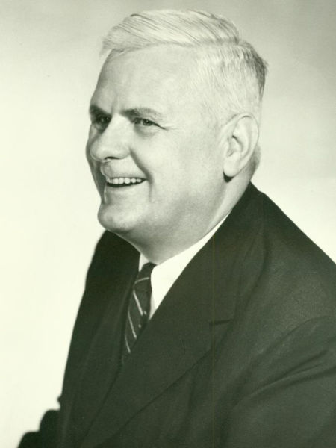
Alonzo Church (1903~1995)
Lambda Calculus
Church-Turing thesis
If an algorithm (a procedure that terminates) exists then there is an equivalent Turing Machine or applicable λ-function for that algorithm.
Notes:
Doctoral students
C. Anthony Anderson
Peter Andrews
George Alfred Barnard
Martin Davis
Leon Henkin
David Kaplan
John George Kemeny
Stephen Kleene
Michael O. Rabin
Hartley Rogers, Jr
J. Barkley Rosser
Nathan Salmon
Dana Scott
Raymond Smullyan
Alan Turing

Slide 16
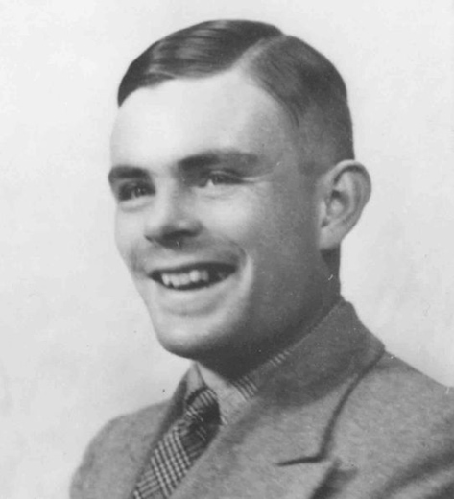
Alan M. Turing (1912~1954)
Turing Machine
Turing Test
Head of Hut 8
Advisor:
Alonzo Church
Notes:
Hut 8 was a section at Bletchley Park (the British World War II codebreaking station) tasked with solving German naval Enigma messages.

Slide 17
Equivalence in Computability
λ Calculus ↔ Turing Machine
  (1) Everything computable by λ Calculus can be computed using the Turing Machine.
  (2) Everything computable by the Turing Machine can be computed with λ Calculus.

Slide 18
Simulate λ Calculus with TM
The initial tape is filled with the initial λ expression
Finite number of reduction rules can be implemented by the finite state automata in the Turing Machine
Start the Turing Machine; it either stops – ending with the λ expression on tape in normal form, or continues forever – the β-reductions never ends.
Notes:
Ask and lead to the content of the slide.
It is also proven by the fact that we can write a program in either Java or C (which are both universal programming languages) to do all the reductions automatically.

Slide 19
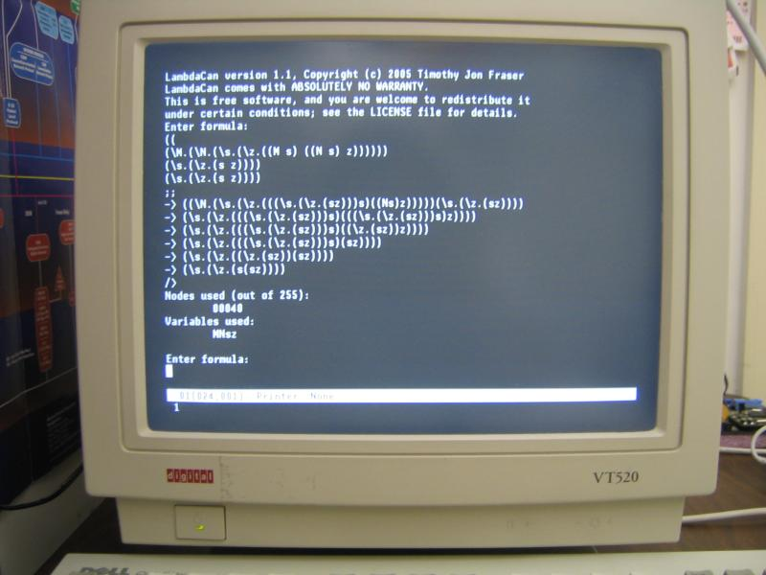
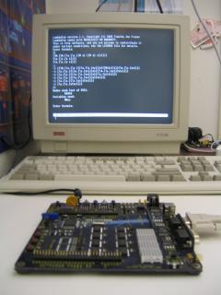
WPI hacker implemented it on Z8 microcontroller
On Zilog Z8 Encore

Slide 20
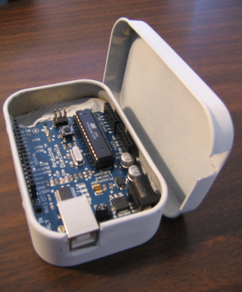
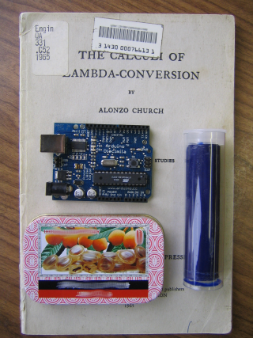
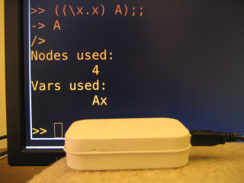
λ Calculus in a Can
Project LambdaCan
Refer to http://alum.wpi.edu/~tfraser/Software/Arduino/lambdacan.html for instructions to build your own λ-can!

Slide 21
Equivalence in Computability
λ Calculus ↔ Turing Machine
  (1) Everything computable by λ Calculus can be computed using the Turing Machine.
  (2) Everything computable by the Turing Machine can be computed with λ Calculus.

Slide 22
Simulate TM with λ Calculus
Simulating the Universal Turing Machine
z
z
z
z
z
z
z
z
z
z
z
z
z
z
z
z
z
z
), X, L
Read/Write Infinite Tape
Mutable Lists
Finite State Machine
Numbers
Processing
Way to make decisions (if)
Way to keep going
¬), #, R
2: look for (
¬(, #, L
1
Start
(, X, R
HALT
#, 1, -
#, 0, -
Finite State Machine

Slide 23
Making Decisions
What does decision mean?
  Choosing different strategies depending on the predicate
What does True mean?
  True is something that when used as the first operand of if, makes the value of the if the value of its second operand:
  if T M N → M
  if F M N → N
Notes:
The red-dotted frame: specifications for the concepts related to making decisions.

Slide 24
Finding the Truth
if ≡ λpca . pca
T ≡ λxy. x
F ≡ λxy. y
if T M N
  ((λpca . pca) (λxy. x)) M N
  →_{β} (λca . (λxy. x) ca)) M N
  →_{β} →_{β} (λxy. x) M N
  →_{β} (λy. M )) N →_{β} M
Try out reducing
(if F T F) on your notes now!
Notes:
make sure to note that this is just one possible way of defining if, T and F - we could define them differently as long as all are changed consistently so the meaning still works.
Since if, T, and F are more readable than their corresponding detailed lambda terms, it’s more convenient to use the primitives’ simplified forms to construct other primitives. From now on, you’d better train yourself to be comfortable to terms that contain predefined primitives. Just keep in mind that you can reduce everything to their corresponding lambda terms whenever you want to according to the existent definitions.

Slide 25
and and or?
and ≡ λxy.(if x y F)
→_{β} λxy.((λpca.pca) x y F)
→_{β} λxy.(x y F)
→_{β} λxy.(x y (λuv.v))
or ≡ λxy.(if x T y)
much more human-readable!
Notes:
BUFFER SLIDE

Slide 26
Simulate TM with λ Calculus
Simulating the Universal Turing Machine
z
z
z
z
z
z
z
z
z
z
z
z
z
z
z
z
z
z
), X, L
Read/Write Infinite Tape
Mutable Lists
Finite State Machine
Numbers
Processing
Way to make decisions (if)
Way to keep going
¬), #, R
2: look for (
¬(, #, L
1
Start
(, X, R
HALT
#, 1, -
#, 0, -
Finite State Machine
X

Slide 27
What is 11?
eleven
elf
undici
十一
11
once
XI
onze
одиннадцать
أحد عش
イレブン

Slide 28
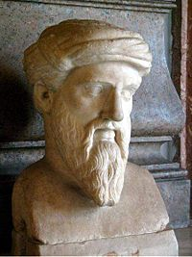
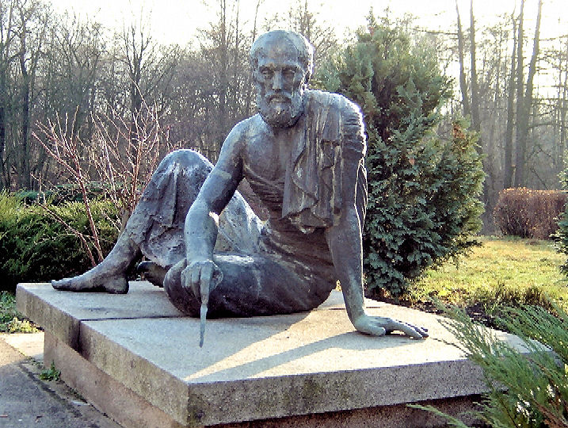
Numbers
The natural numbers had their origins in the words used to count things
Numbers as abstractions
pred (succ N) → N
succ (pred N) → N
pred (0) → 0
succ (zero) → 1
Notes:
Pythagoras
Archimedes
Specification for the concept of numbers is in the red-dotted frame.

Slide 29
Defining Numbers
In Church numerals, n is represented as a function that maps any function f to its n-fold composition.
0 ≡ λ f x. x
1 ≡ λ f x. f (x)
2 ≡ λ f x. f (f (x))
Notes:
Reveal that “n f x = f ( f ( … (x) ) )”

Slide 30

Defining succ and pred
succ ≡ λ n f x. f (n f x)
pred ≡ λ n f x. n (λgh. h (g f )) (λu. x) (λu. u)
succ 1 →_{β} ?
We’ll see later how to deduce the term for pred using knowledge about pairs.

Slide 31
Simulate TM with λ Calculus
Simulating the Universal Turing Machine
z
z
z
z
z
z
z
z
z
z
z
z
z
z
z
z
z
z
), X, L
Read/Write Infinite Tape
Mutable Lists
Finite State Machine
Numbers
Processing
Way to make decisions (if)
Way to keep going
¬), #, R
2: look for (
¬(, #, L
1
Start
(, X, R
HALT
X
#, 1, -
#, 0, -
Finite State Machine
X

Slide 32
Defining List
List is either
  (1) null; or
  (2) a pair whose second element is a list.
How to define null and pair then?
Notes:
Could go through 32-36 very quickly, just saying, yes it is possible, and making it clear they aren't supposed to follow exactly how.

Slide 33
null, null?, pair, first, rest
null? null → T
null? ( pair M N ) → F
first ( pair M N ) → M
rest ( pair M N) → N
Notes:
Specifications for defining concepts related to pair and list.

Slide 34
null and null?
null ≡ λx.T
null? ≡ λx.(x λyz.F)
null? null →_{β} (λx.(x λyz.F)) (λx. T)
→_{β} (λx. T)(λyz.F)
→_{β} T

Slide 35
Defining Pair
A pair [a, b] = (pair a b) is represented as
λ z .z a b
first ≡ λp.p T
rest ≡ λp.p F
pair ≡ λ x y z .z x y
first (cons M N)
→_{β} ( λp.p T ) (pair M N)
→_{β} (pair M N) T →_{β} (λ z .z M N) T
→_{β} T M N
→_{β} M

Slide 36
Defining pred
C ≡ λpz.(z (succ ( first p )) ( first p ) )
Obviously, C [n, n-1] →_{β} [n+1, n], i.e., C turns a pair [n, n-1] to be [n+1, n].
pred ≡ rest (λn . n C (λz.z 0 0))

Slide 37
Simulate TM with λ Calculus
Simulating the Universal Turing Machine
z
z
z
z
z
z
z
z
z
z
z
z
z
z
z
z
z
z
), X, L
Read/Write Infinite Tape
Mutable Lists
Finite State Machine
Numbers
Processing
Way to make decisions (if)
Way to keep going
¬), #, R
2: look for (
¬(, #, L
X
1
Start
(, X, R
HALT
X
#, 1, -
#, 0, -
Finite State Machine
X

Slide 38
Simulate Recursion
(λ f. ((λ x.f (xx)) (λ x. f (xx)))) (λz.z)
→_{β} (λx.(λz.z)(xx)) (λ x. (λz.z)(xx))
→_{β} (λz.z) (λ x.(λz.z)(xx)) (λ x.(λz.z)(xx))
→_{β} (λx.(λz.z)(xx)) (λ x.(λz.z)(xx))
→_{β} (λz.z) (λ x.(λz.z)(xx)) (λ x.(λz.z)(xx))
→_{β} (λx.(λz.z)(xx)) (λ x.(λz.z)(xx))
→_{β} ...
This should give you some belief that we might be able to do it. We won’t cover the details of why this works in this class.

Slide 39
Simulate TM with λ Calculus
Simulating the Universal Turing Machine
z
z
z
z
z
z
z
z
z
z
z
z
z
z
z
z
z
z
), X, L
Read/Write Infinite Tape
Mutable Lists
Finite State Machine
Numbers
Processing
Way to make decisions (if)
Way to keep going
¬), #, R
2: look for (
¬(, #, L
X
1
Start
(, X, R
HALT
X
#, 1, -
#, 0, -
Finite State Machine
X
X

Slide 40
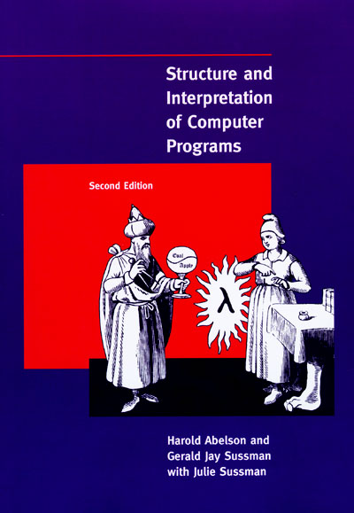

Introducing Scheme
Scheme is a dialect of LISP programming language
Computation in Scheme is a little higher level than in λ-Calculus in the sense that the more “human-readable” primitives (like T, F, if, natural numbers, null, null?, and cons, etc) have already been defined for you.
The basic reduction rules are exactly the same.
Notes:
If time permits, show the following primitives in DrScheme:
(cons 1 null)
(car (cons 1 2))
(+ 100 11)

Slide 41
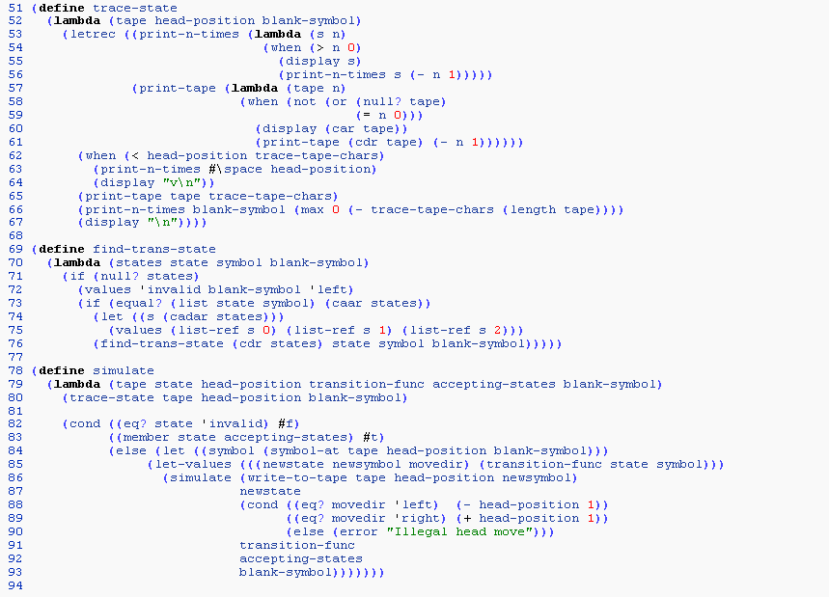
A Turing simulator in Scheme

Slide 42
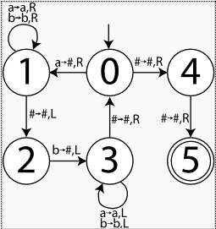
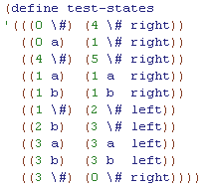
TM Simulator demonstration
A
T
u
r
i
n
g
M
a
c
h
i
n
e
r
e
c
o
g
n
i
z
i
n
g
a
n
b
n
E
n
c
o
d
i
n
g
o
f
t
h
e
F
S
M
i
n
S
c
h
e
m
e
.
Notes:
Run the real example in DrScheme if time permits.

Slide 43
Summary: TM and λ Calculus
λ Calculus emphasizes the use of transformation rules and does not care about the actual machine implementing them.
It is an approach more related to software than to hardware
Many slides and examples are adapted from materials developed for Univ. of Virginia CS150 by David Evans.

